Slide 1
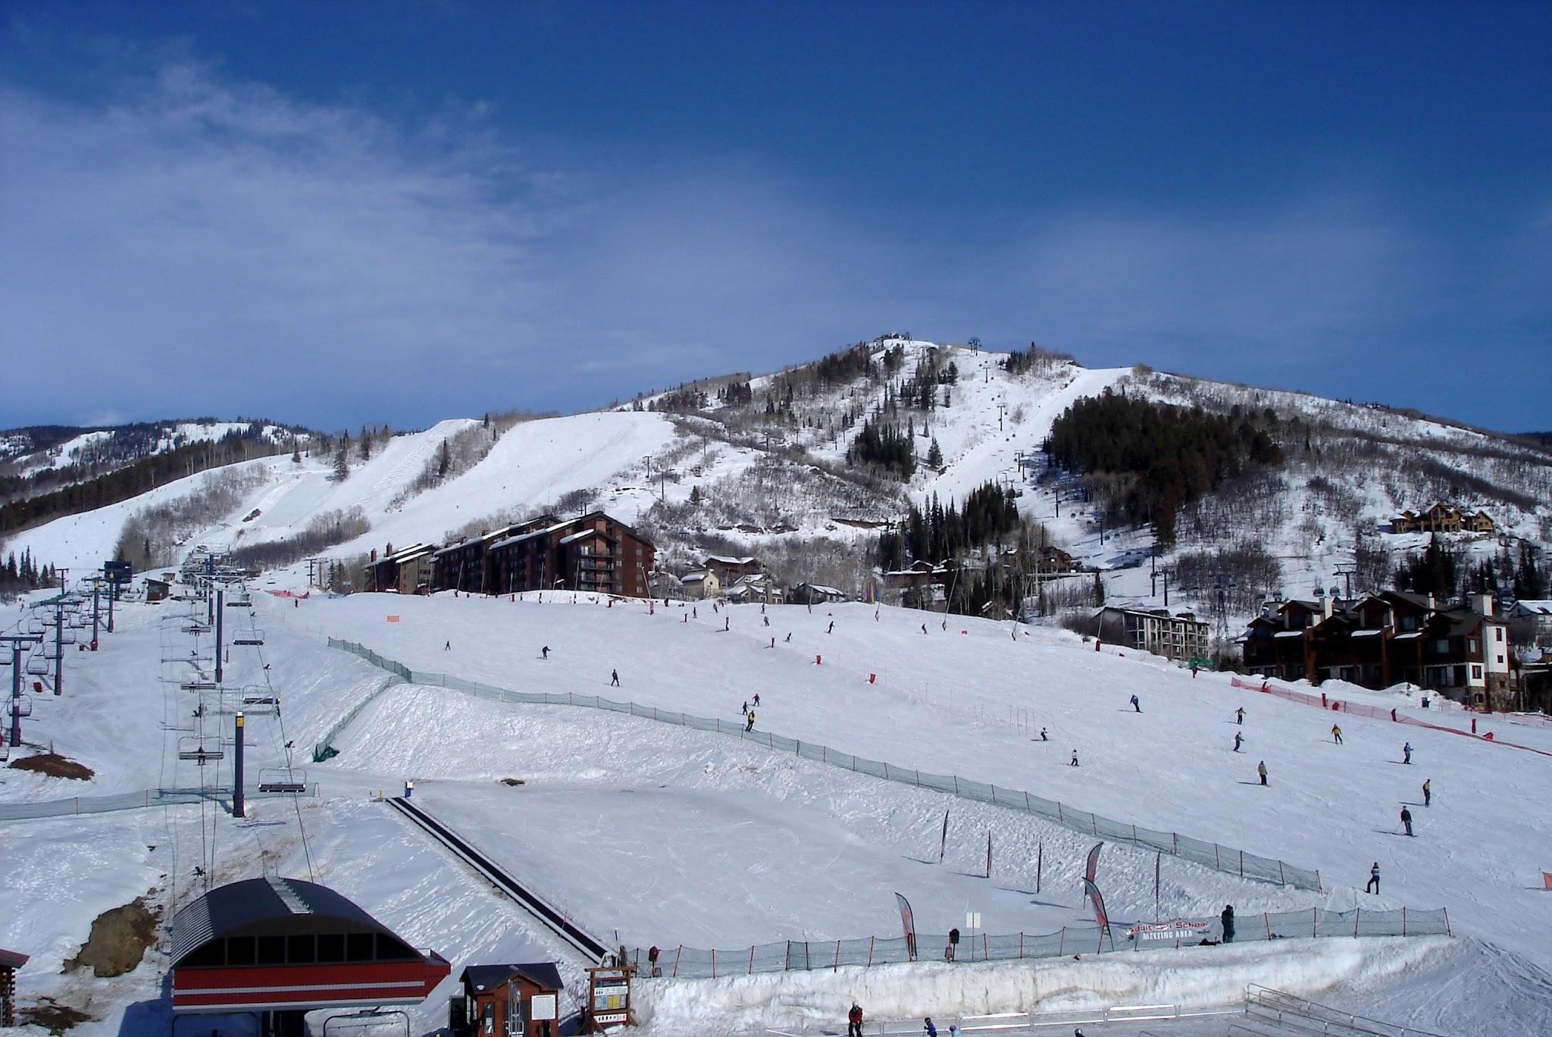
Big Mountain Ski Resort

Slide 2
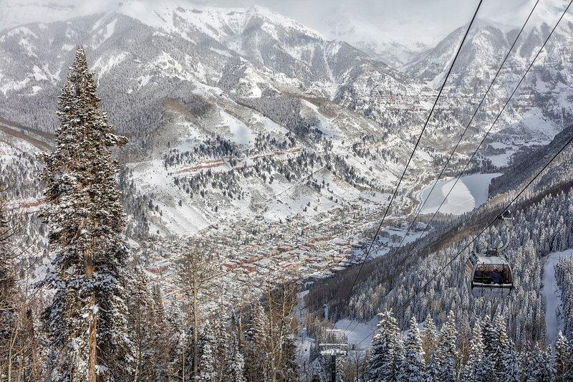
Problem Identification
Pricing Strategy Challenge at Big Mountain Resort
Big Mountain Resort's current ticket pricing is under market value when compared to resorts with similar facilities.
Despite superior amenities and a larger skiable area, Big Mountain's pricing does not fully capitalize on its market position.
Increased operational costs, including the new chair lift, necessitate a review of ticket pricing strategy.
Competitive analysis indicates room for potential price adjustment to align with market expectations and resort offerings.

Slide 3
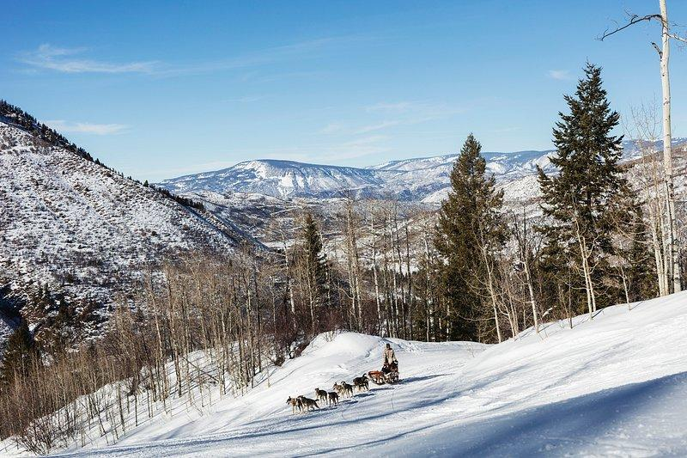
Problem Identification
Facility Utilization and Operational Efficiency
Analysis of run utilization suggests that some of the least used runs could be considered for closure to reduce maintenance costs.
The resort's extensive snow-making capabilities are a significant asset that could be better leveraged in pricing strategy.
A need to balance operational efficiency with guest satisfaction, particularly in terms of run availability and lift capacity.
Opportunities exist to enhance vertical drop and run variety, further distinguishing Big Mountain in the competitive landscape.

Slide 4
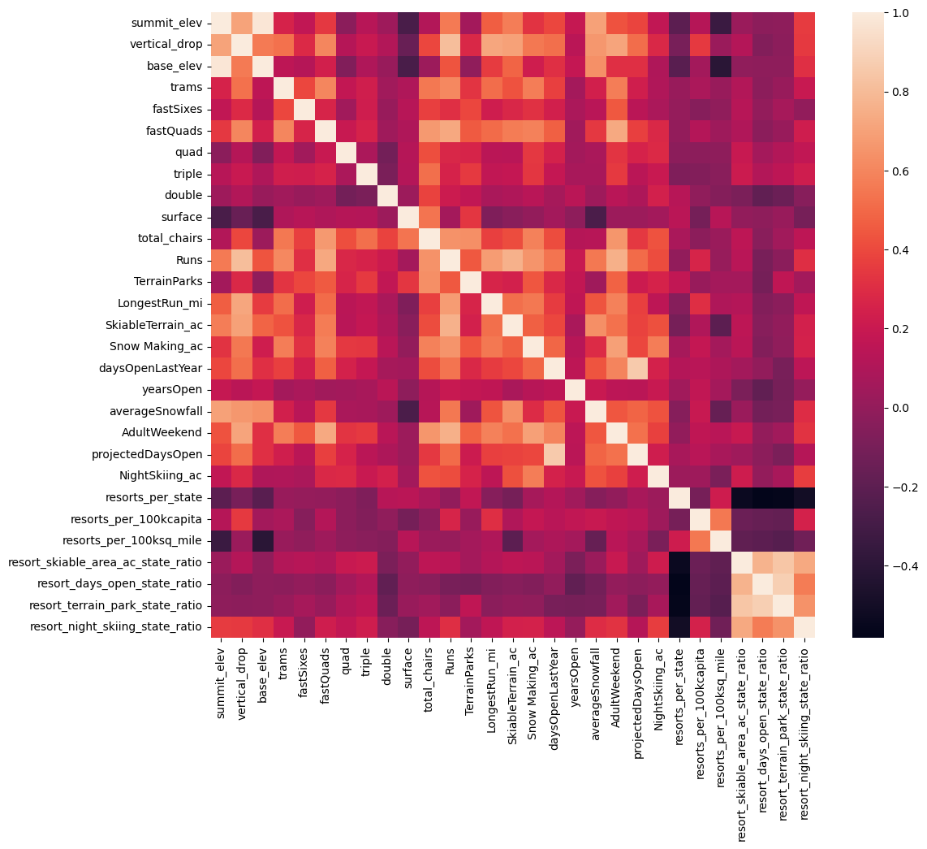
Recommendation and Key Findings
Recommendation: Strategic Pricing and Facility Enhancement
Implement a targeted ticket price increase to more accurately reflect Big Mountain's value proposition and market position.
Explore strategic closure of underutilized runs to optimize operational costs without significantly impacting guest experience.
Consider further enhancements to vertical drop and snow-making capabilities to bolster market differentiation.
Adoption of a dynamic pricing model could allow more flexibility in responding to market demand and competitive pressures.

Slide 5
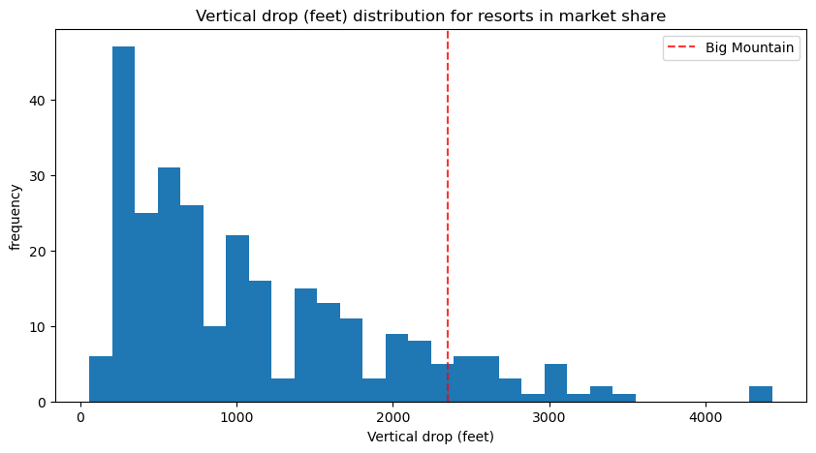
Modeling Results and Analysis
Pricing Model Insights
The predictive pricing model indicates Big Mountain could support a higher ticket price based on its amenities compared to competitors.
Key features impacting ticket price include vertical drop, number of runs, and snow-making area.
Scenario analysis highlights the potential for a 10% to 15% ticket price increase without diminishing market competitiveness.

Slide 6
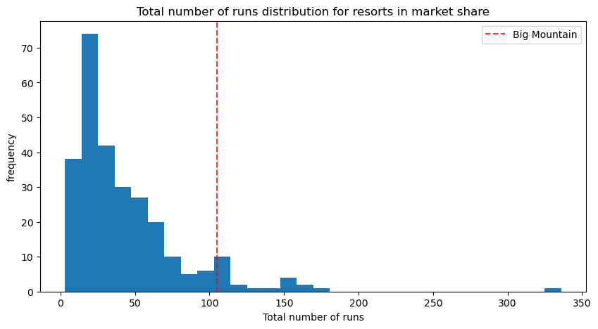
Modeling Results and Analysis
Operational Cost-Benefit Analysis
Cost analysis of maintaining vs. closing the least utilized runs shows potential for significant savings with minimal impact on guest experience.
Adding snow-making to new runs offers a marginal price increase benefit, reinforcing the value of existing snow-making infrastructure.
The introduction of a new lift to service extended runs presents an opportunity for increasing vertical drop, aligning with premium pricing potential.

Slide 7
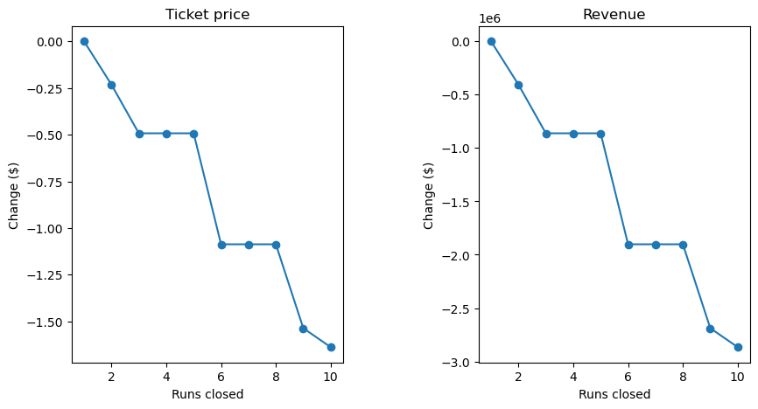
Modeling Results and Analysis
Scenario Testing and Market Position
Tested scenarios including run closures, lift additions, and snow-making expansions demonstrate varying impacts on pricing potential and operational costs.
Recommendations prioritize minimal guest disruption while maximizing return on investment for enhancements and operational adjustments.

Slide 8
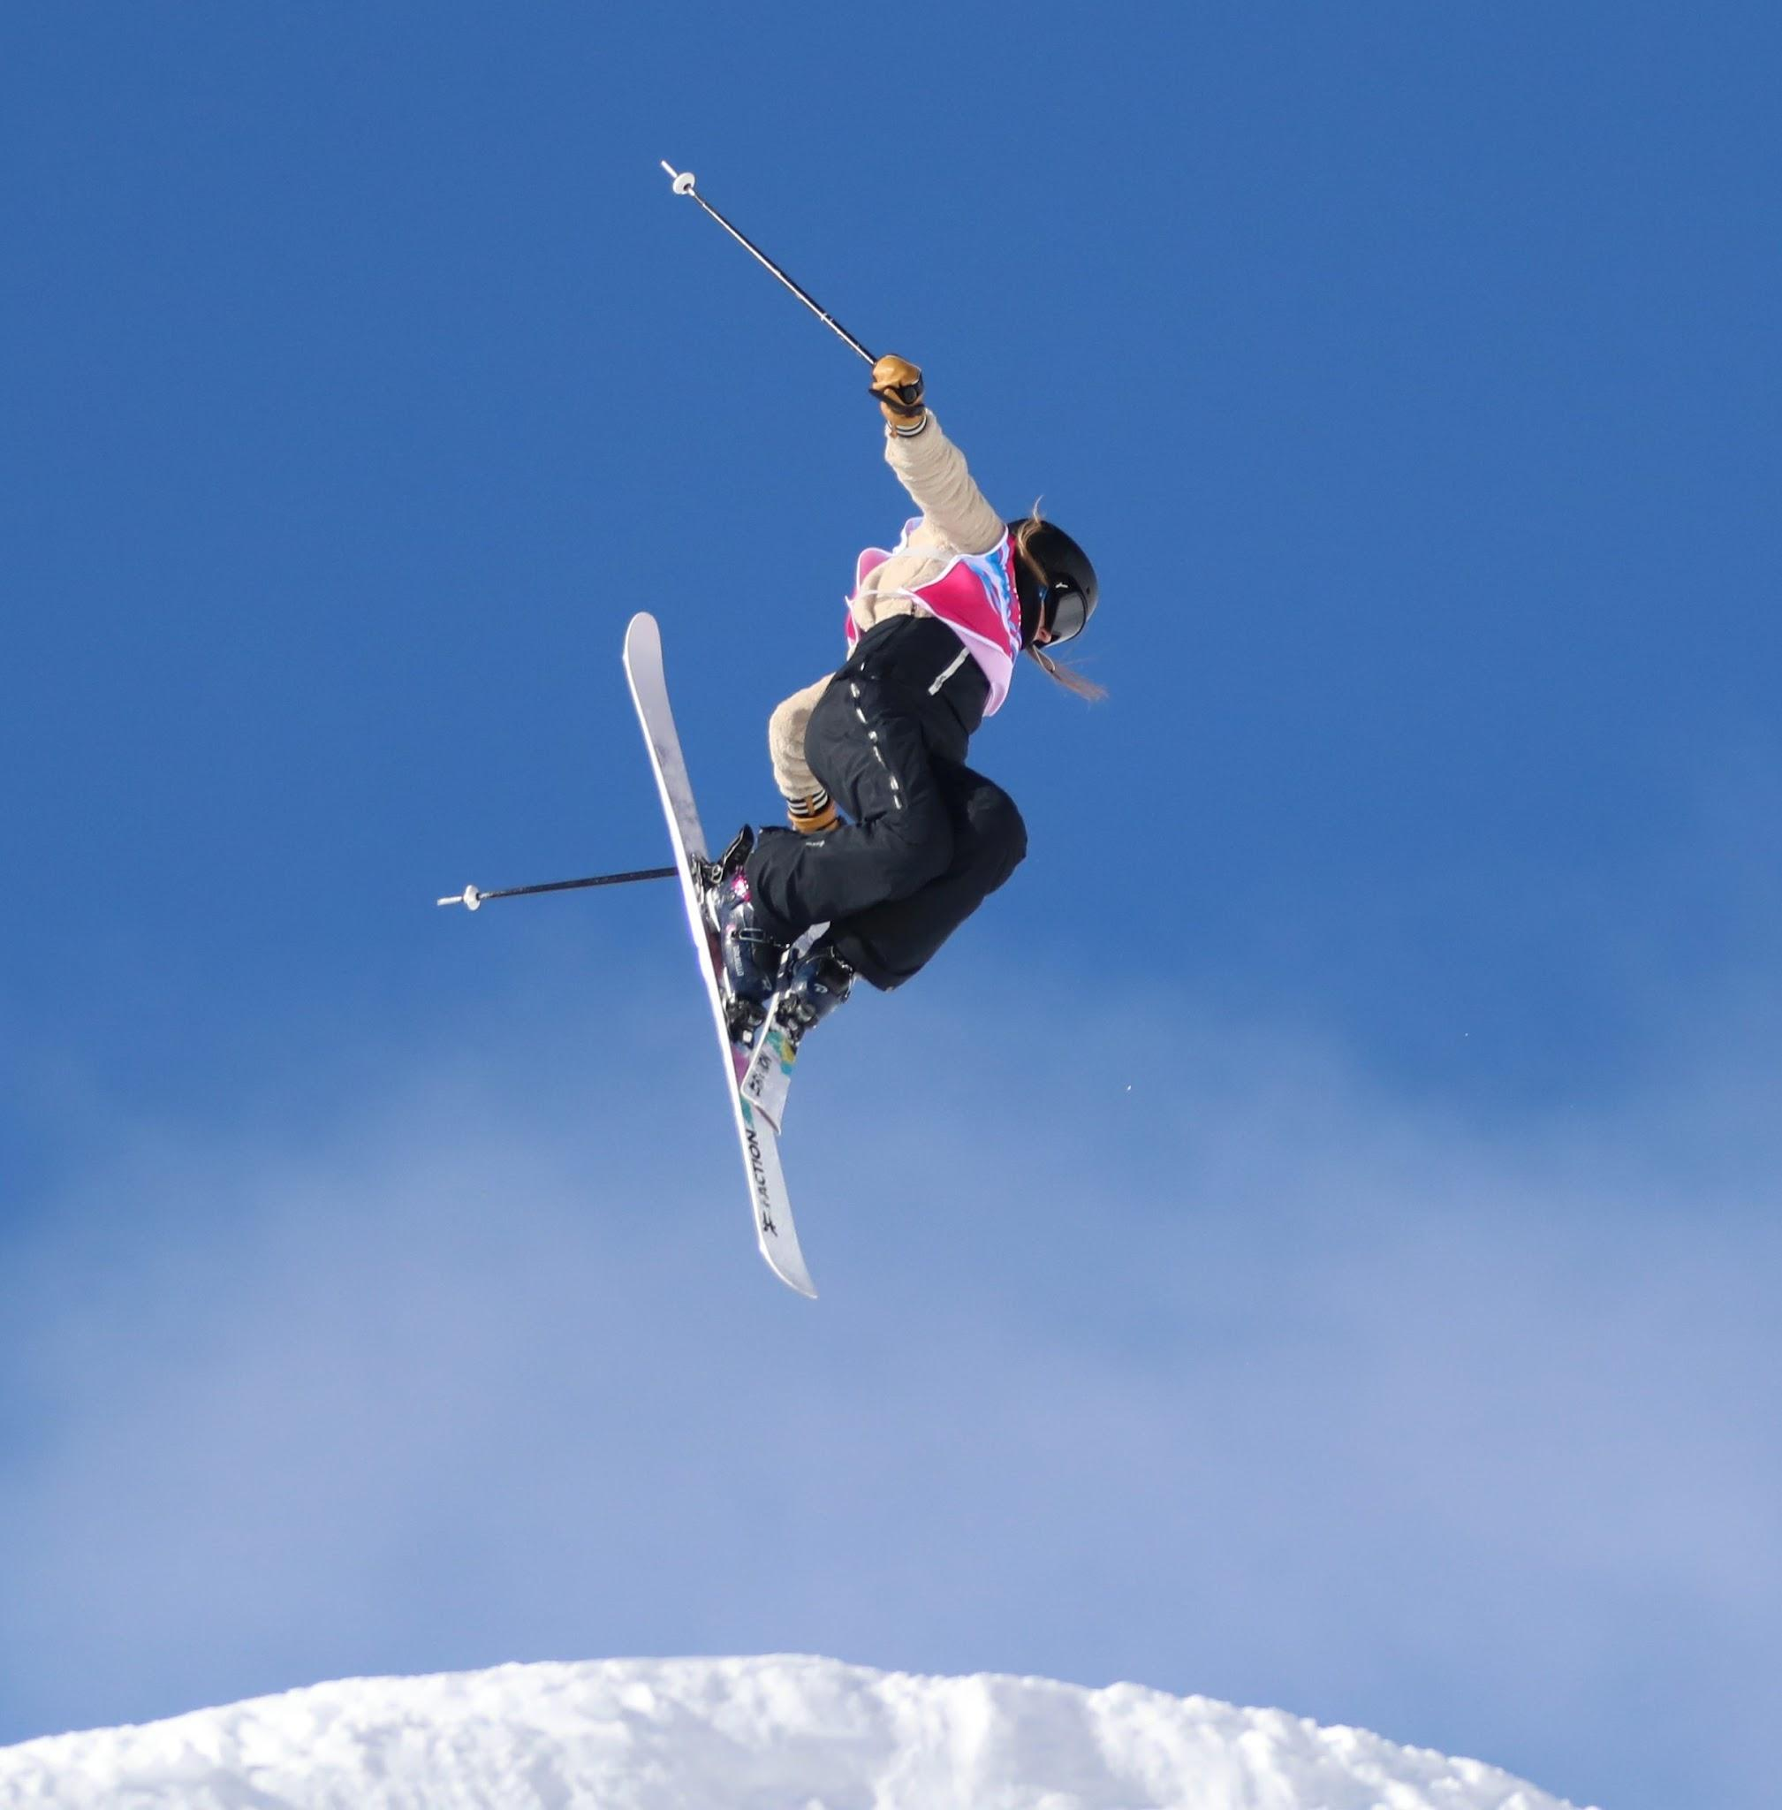
Modeling Results and Analysis
Competitive Advantage and Sustainability
Enhanced pricing strategy positions Big Mountain Resort as a leader in value and experience within the competitive ski resort market.
Focus on sustainable operation and strategic facility use ensures long-term profitability and guest satisfaction.

Slide 9
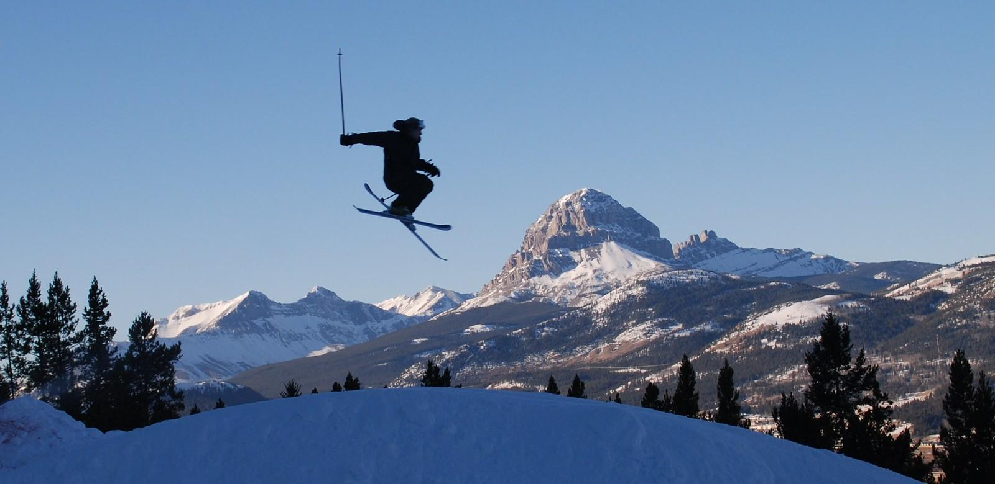
Summary and Conclusion
Strategic Recommendation for Future Growth
Immediate implementation of a refined pricing strategy to better match Big Mountain's market positioning and offerings.
Adoption of recommended operational changes to enhance efficiency and guest experience, ensuring a sustainable competitive edge.
Continuous evaluation of resort facilities and guest preferences to inform future enhancements and pricing adjustments.
Commitment to leveraging data-driven insights for strategic decision-making to navigate market dynamics and drive revenue growth.

